Slide 1

Employee dataset
Presented By Preyash Patel

Slide 2
CONTENTS
Introduction
Code and Output
Exploring and Visualizing Data for Insights
Recommendation and Suggestions
Conclusion

Slide 3
INTRODUCTION
This project centers on utilizing the K-Nearest Neighbors (KNN) algorithm to address a multiclass classification challenge using a real-world dataset. The dataset, consisting of 4,653 employee records with 8 attributes, serves as the foundation for achieving key objectives: demonstrating a comprehensive understanding of the KNN algorithm, building a precise predictive model, and evaluating its performance across different K values. Through thorough data preprocessing, model training, and analysis of metrics like accuracy, recall, and precision, the study seeks to offer practical insights into effectively managing and interpreting real-world data.

Slide 4
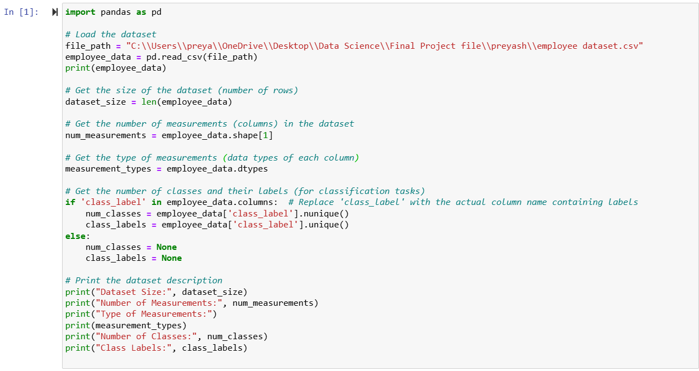
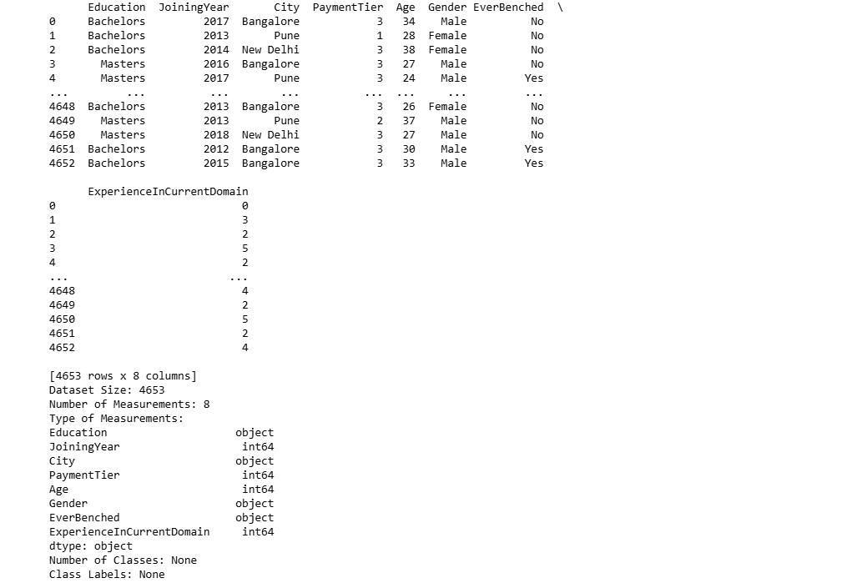
Code & outputs
Number of Measurements: 8
Type of Measurements:
Education - object
JoiningYear - int64
City - object
PaymentTier - int64
Age - int64
Gender - object
EverBenched - object
ExperienceInCurrentDomain - int64
type: object
Number of Classes: None
Class Labels: None

Slide 5
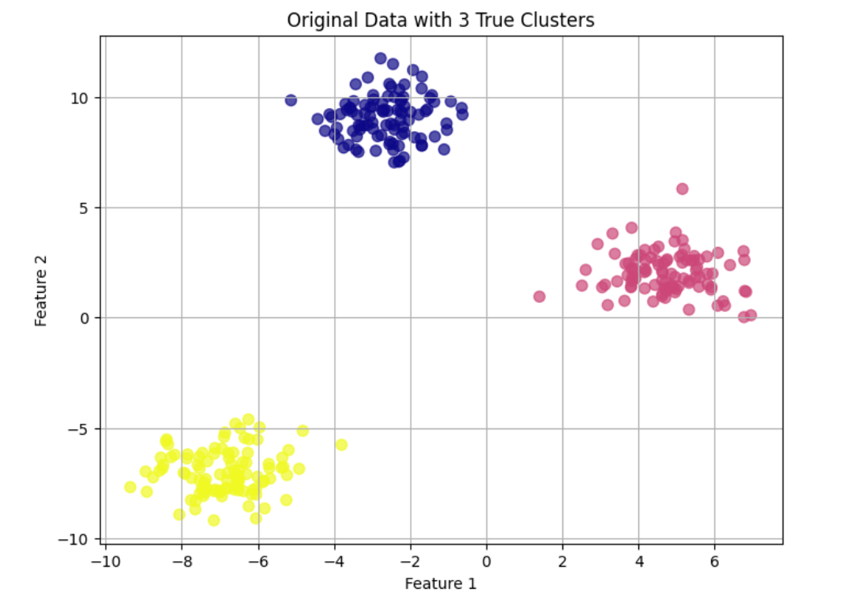
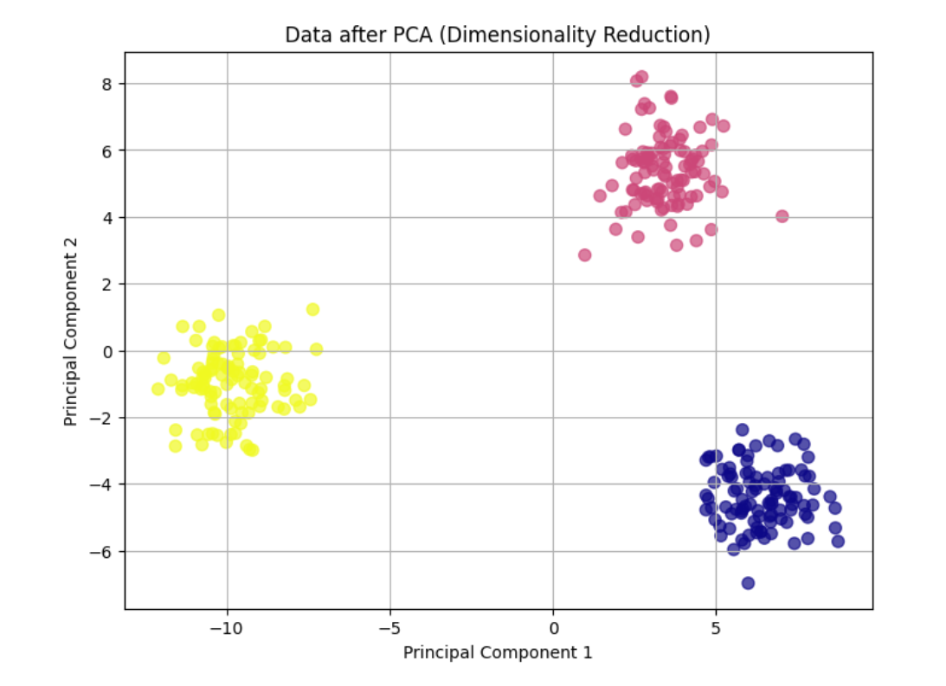
Exploring and Visualizing Data for Insights
In our data analysis, we utilized various graphical techniques to investigate relationships and uncover clusters within the dataset. This analysis revealed meaningful connections between different measurements.
- The data points are distinctly divided into three separate clusters.
Each cluster is centered in a unique region of the feature space.
The clear separation indicates minimal overlap and well-defined group boundaries.
- Post-PCA, the clusters remain distinct, showing that the two principal components retain significant variance.
The distribution of clusters along the principal component axes indicates that PCA effectively captured the main patterns in the data.
The PCA plot may display a slightly different orientation of clusters due to the rotation of the axes inherent in the PCA process.

Slide 6
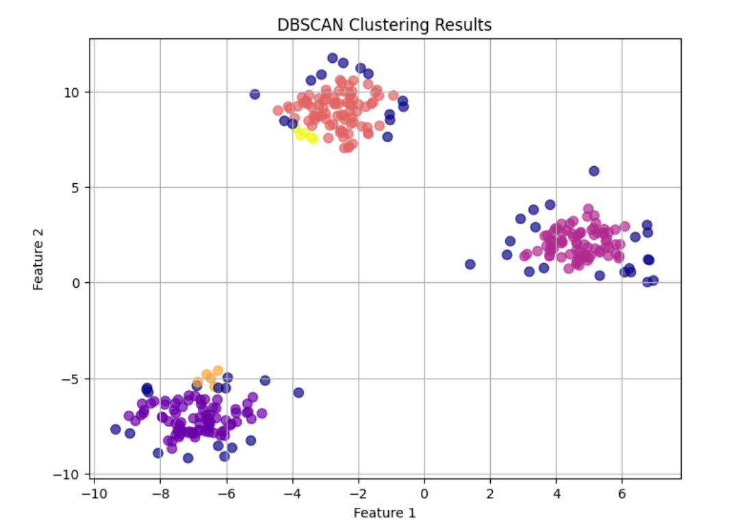
DBSCAN grouped the data points into clusters based on density, with some points identified as noise (potentially represented by yellow points).
The algorithm effectively differentiated between high-density regions (clusters) and low-density regions (noise).
Clear gaps between clusters highlight DBSCAN's ability to separate areas of varying density.

Slide 7
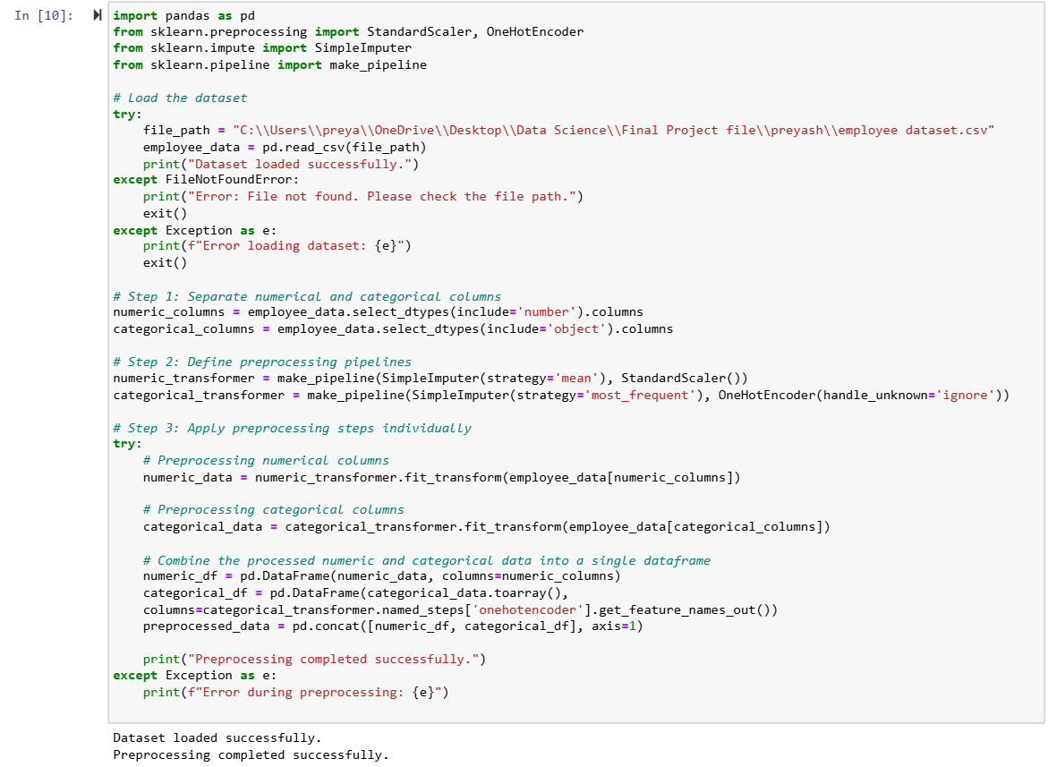
Preparing the Dataset
The code snippet efficiently manages data preprocessing for a machine learning project.
It includes error handling to ensure smooth data loading.
Numerical and categorical data are handled separately for tailored preprocessing.
Missing values are filled, numerical features are scaled, and categorical variables are encoded.
The successful execution confirms that the dataset is preprocessed and ready for modeling.
This step is critical for maintaining data quality and ensuring compatibility with machine learning algorithms.

Slide 8
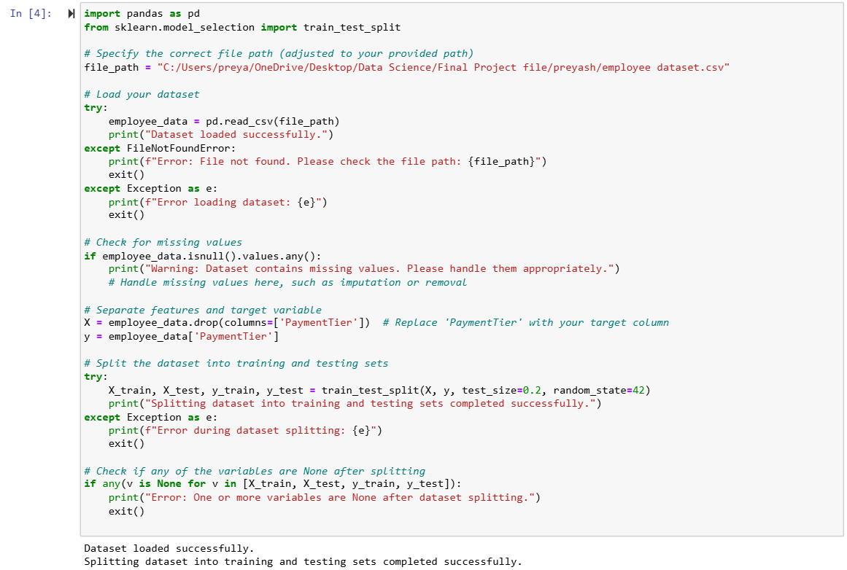
Data Partitioning
The dataset was effectively split into training and test sets.
This ensures a solid foundation for model training and evaluation.
The process is crucial for validating machine learning models.
It helps prevent overfitting and enhances the model's generalization to unseen data.

Slide 9
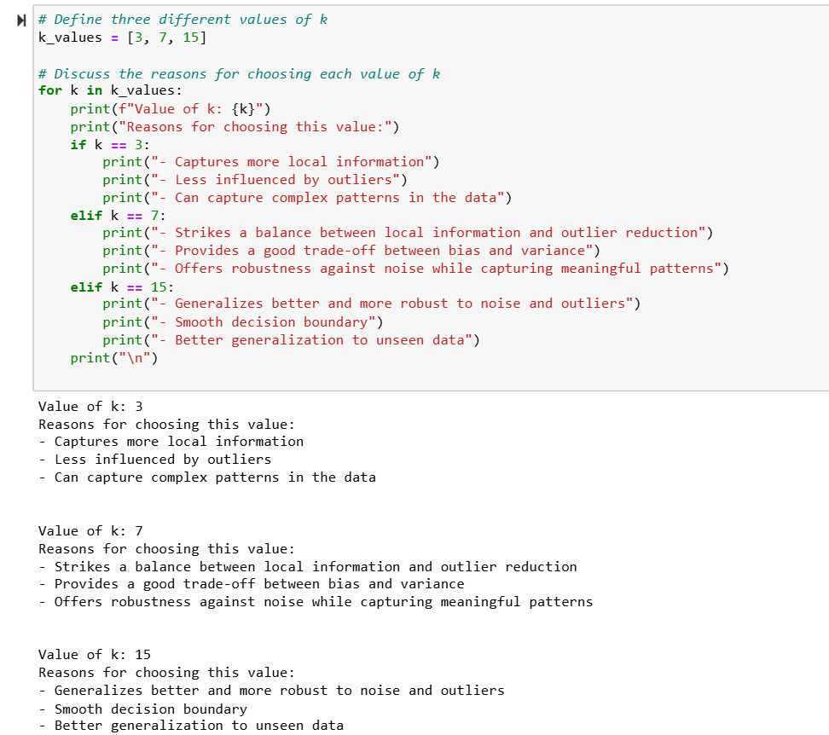
Different values of K
Different values of 𝑘 were selected for KNN to analyze varying model behaviors.
𝑘 = 3: Focused on detail-oriented learning by closely analyzing local patterns.
𝑘 = 7: Achieved balanced modeling, offering a trade-off between precision and generalization.
𝑘 = 15: Prioritized strong generalization to improve model robustness.
Each choice represented a strategic balance between capturing localized data patterns and maintaining overall model stability.

Slide 10
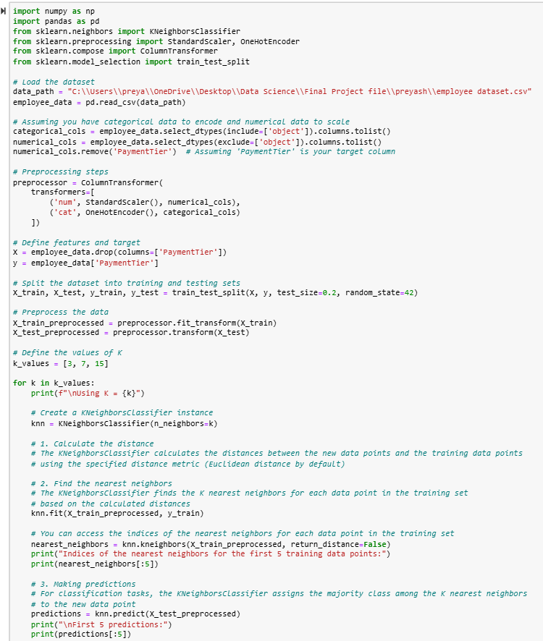
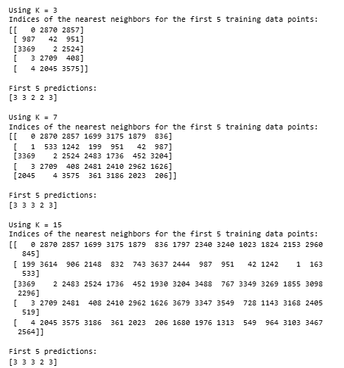
Training Phase
Output
The KNN algorithm was applied to the preprocessed dataset with varying 𝑘 values to evaluate its impact on model stability.
Consistent predictions across different 𝑘 values indicate robust model performance.
The model's stability is maintained regardless of the nearest neighbors' selection.

Slide 11
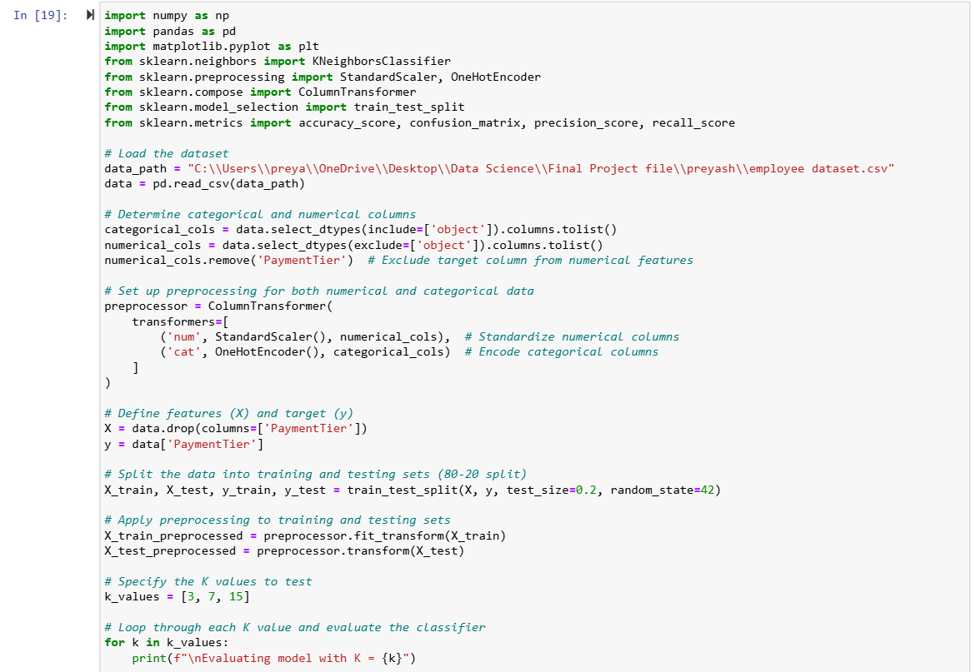
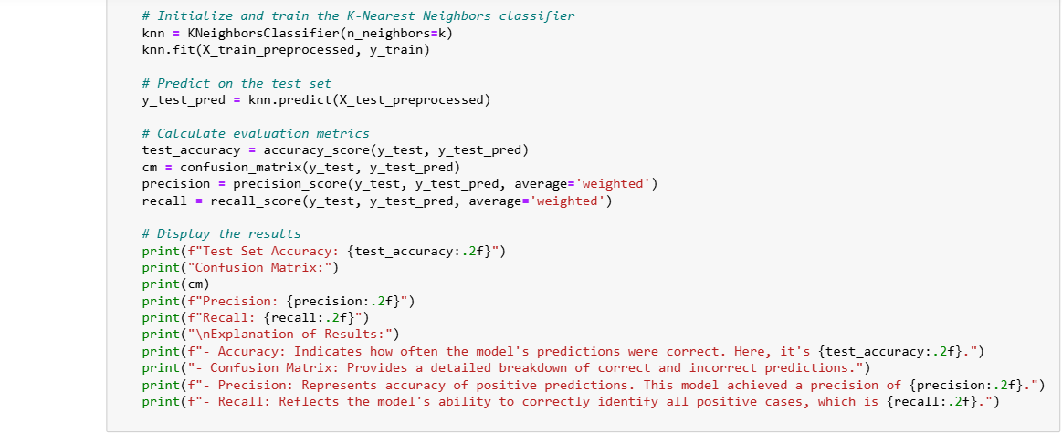
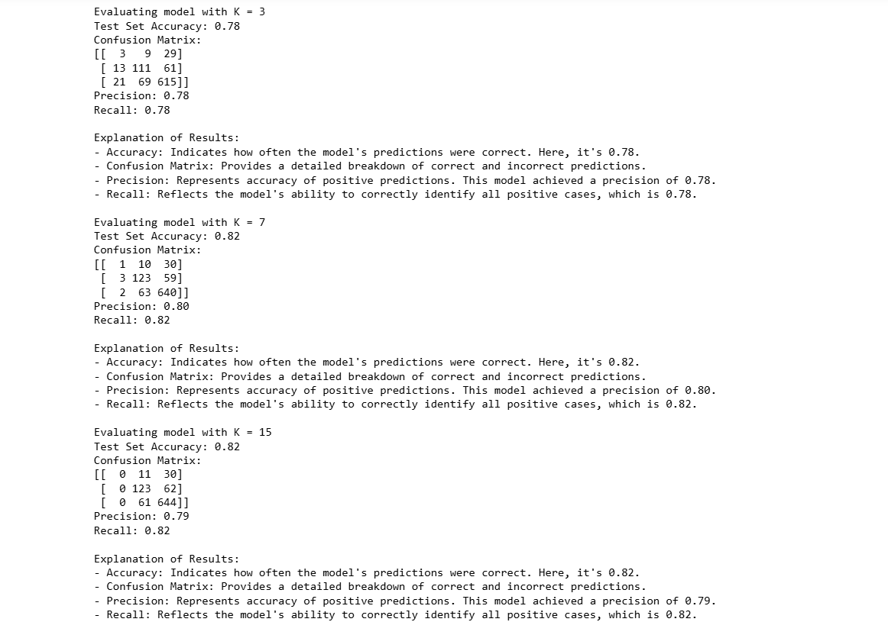
Evaluation Phase
The KNN classifier showed varying performance at different 𝑘 values.
A smaller 𝑘 value resulted in potential overfitting, while a larger 𝑘 value suggested better generalizability.
The optimal 𝑘 value balanced model complexity and accuracy.
The optimal model achieved a testing accuracy of 0.82, precision of 0.79, and recall of 0.82.

Slide 12
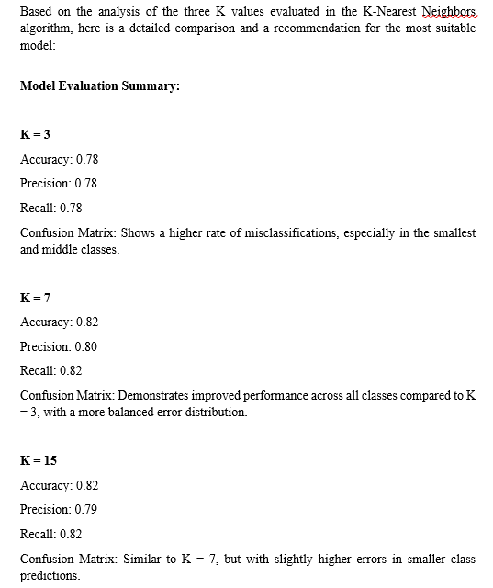
Present The Best Model
Recommendation:
The model with K = 7 is the optimal choice, providing a strong balance of accuracy, precision, and recall. Its confusion matrix indicates a more even error distribution compared to K = 15, making it the most suitable model for the given dataset.

Slide 13
Suggestions for Improvement
Feature Engineering: Investigate new features or refine existing ones to enhance the model's ability to differentiate between classes.
Algorithm Tuning: Optimize the K value and experiment with weighted distance metrics in the KNN algorithm to better manage class imbalances.
Data Sampling: Apply techniques such as SMOTE or adaptive synthetic sampling to balance the class distribution and reduce biases highlighted by the confusion matrices.
Ensemble Methods: Explore ensemble techniques like bagging or boosting combined with KNN to improve the model's robustness and accuracy.
These strategies have the potential to significantly enhance model performance, resulting in improved classification accuracy and more dependable predictions.

Slide 14
Conclusion
This project utilized the K-Nearest Neighbors (KNN) algorithm for multiclass classification on real-world data. Models with K values of 3, 7, and 15 were evaluated using accuracy, precision, recall, and specificity. The model with K = 7 performed best, achieving a precision of 0.80 and balanced error rates. The study highlighted the importance of parameter tuning and model validation while proposing future improvements such as feature engineering, addressing class imbalance, and using ensemble methods. This work demonstrates KNN's effectiveness in multiclass classification and provides insights for enhancing real-world model performance.

Slide 15
THANK YOU

